Slide 1
Roman Culture

Slide 2
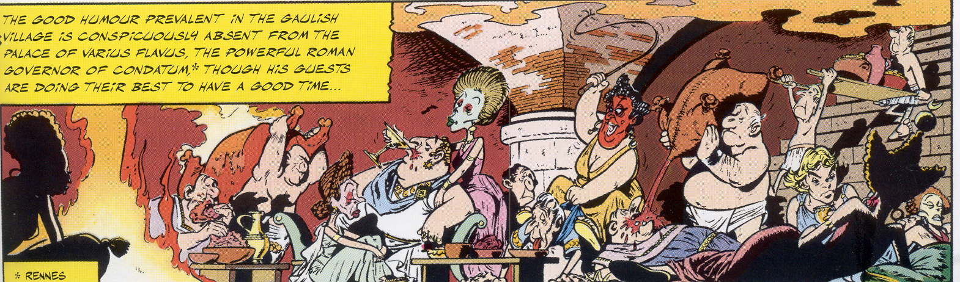
What about the Romans? What did they eat?

Slide 3
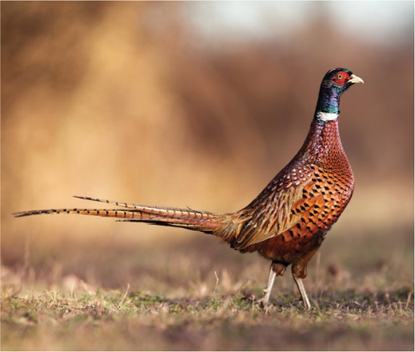
What about the Romans? What did they eat?
For meat: Cow, pig, goat, sheep. rabbits, snails, boar, pheasants, peacocks, chicken, fish and oysters (raw with honey)
A pheasant

Slide 4

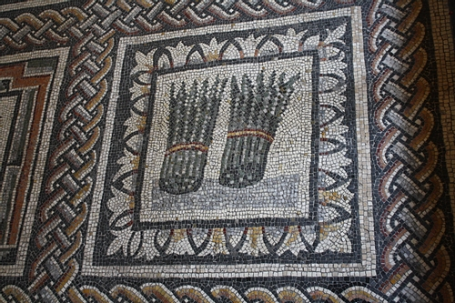

For vegetables, beans, peas, carrots, asparagus, lettuce, rice, artichokes, leeks, cucumbers, mushrooms, onions, cabbage, olives

Slide 5
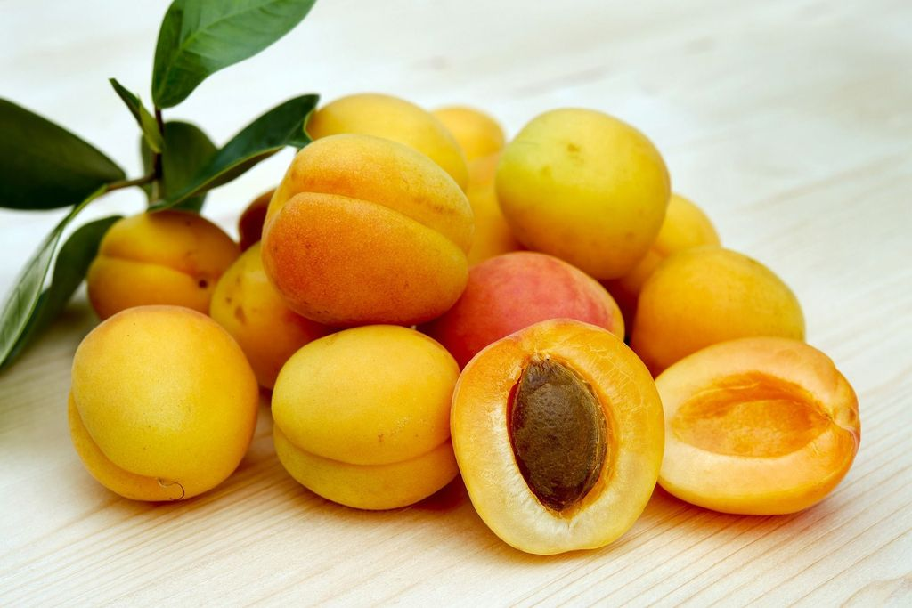
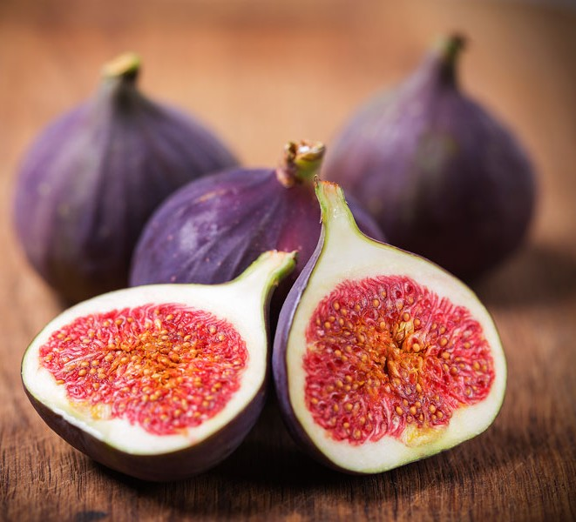
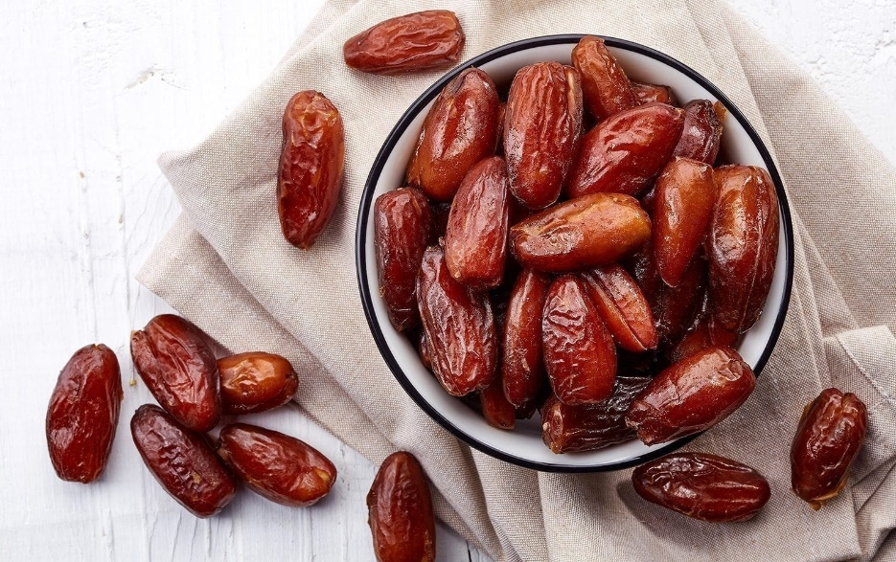
For fruit: raisins, apples, apricots, melons peaches, cherries, grapes, oranges, pineapples, dates, figs, bananas,
Pears, plums

Slide 6
The Roman diet was very similar to ours
But what’s missing?

Slide 7
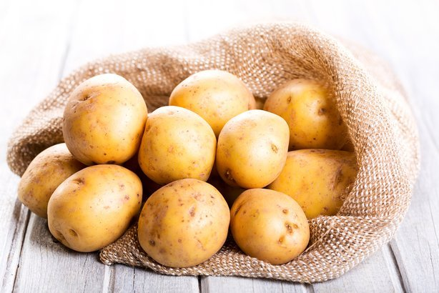
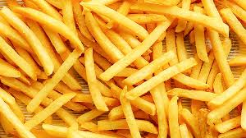

Slide 8
What about Roman delicacies?
Tree fungus, jellyfish and eggs, dormice in honey, boiled ostrich parrot tongue pie

Slide 9
Rich people would have many slaves, at parties Greek storytellers would entertain, also, musicians and maybe a play

Slide 10
Description of a fancy Roman meal
"After a generous rubdown with oil, we put on dinner clothes. We were taken into the next room where we found three couches drawn up and a table, very luxuriously laid out, awaiting us. We were invited to take our seats. Immediately, Egyptian slaves came in and poured ice water over our hands.

Slide 11
Description of a fancy Roman meal
The starters were served. On a large tray stood a donkey made of bronze. On its back were two baskets, one holding green olives, and the other black. On either side were dormice, dipped in honey and rolled in poppy seed. nearby, on a silver grill, piping hot, lay small sausages. As for wine, we were fairly swimming in it."

Slide 12
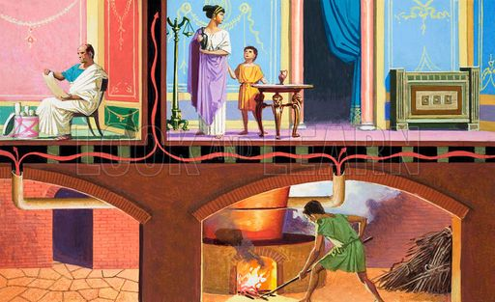
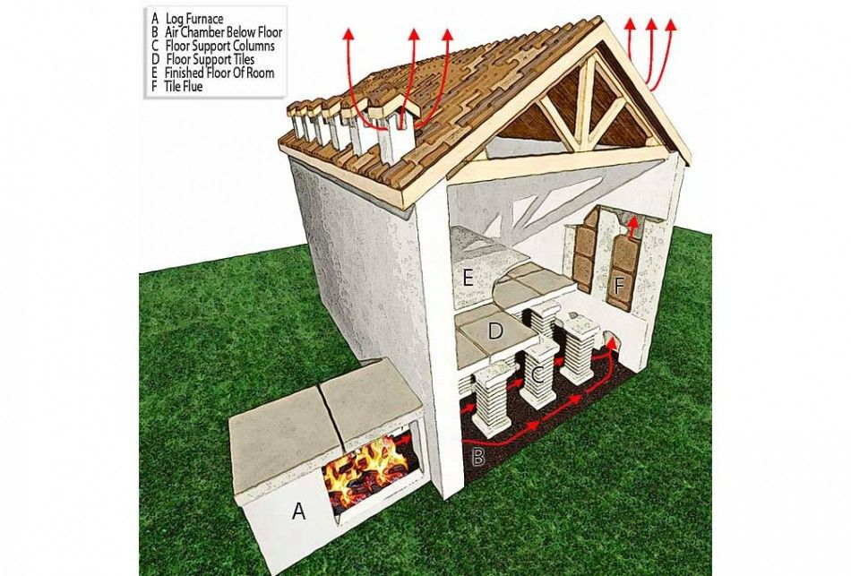
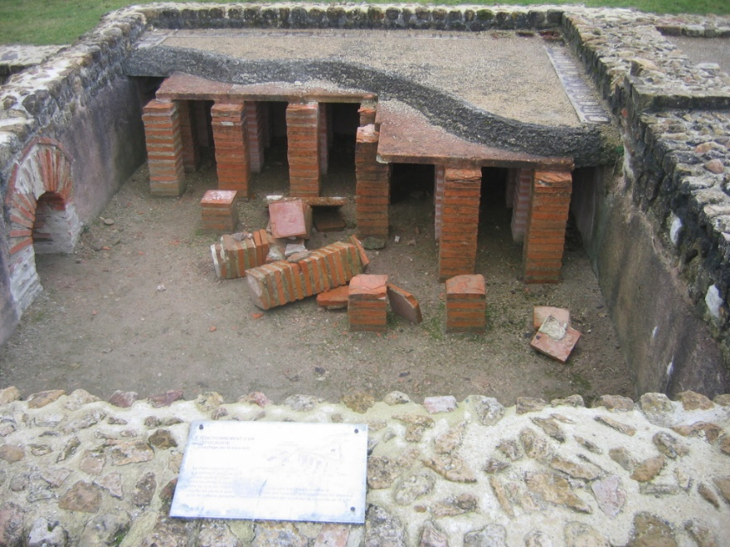
The rich lived in villas in the countryside
The city also had too much disease, too many people
Thousands of years ago the Romans had heated flooring! Also, they invented glass windows!

Slide 13
the poor lived in apartments in the city, had no running water on the first floor, and had no bathrooms!

Slide 14
Roman Public places
Tiles had spaces between them and the walls so the warm air from the fire could circulate and warm the walls!

Slide 15
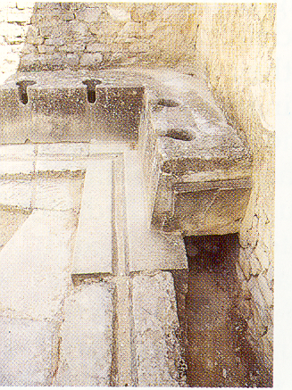
A public bath

Slide 16
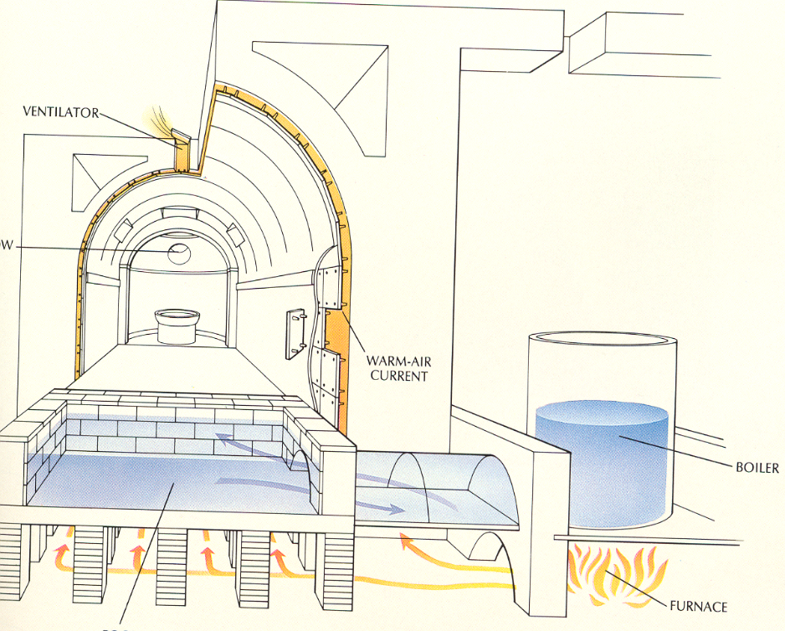
The Romans were still quite clean, going to baths that had gyms with reading rooms, massage rooms and rooms to play board games.
Tiles had spaces between them and the walls so the warm air from the fire could circulate and warm the walls!

Slide 17
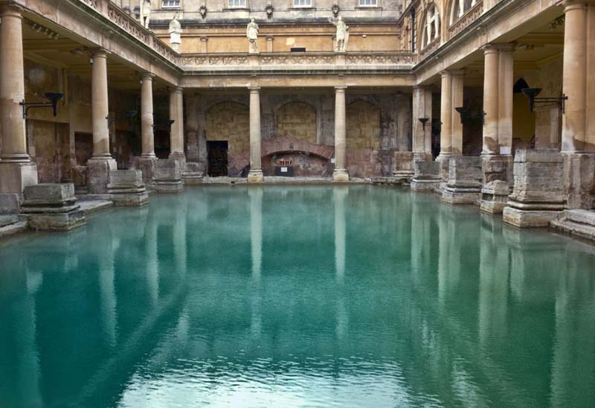

Slide 18
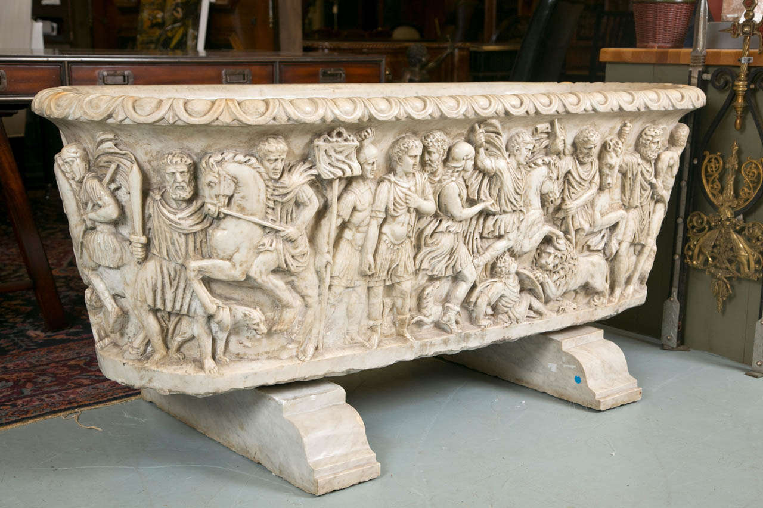
A bathtub

Slide 19
Roman public entertainment
Tiles had spaces between them and the walls so the warm air from the fire could circulate and warm the walls!

Slide 20
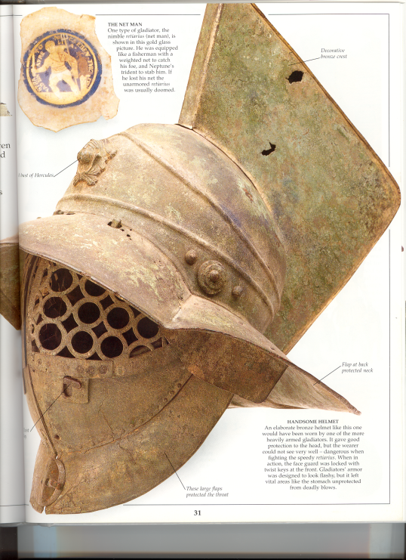
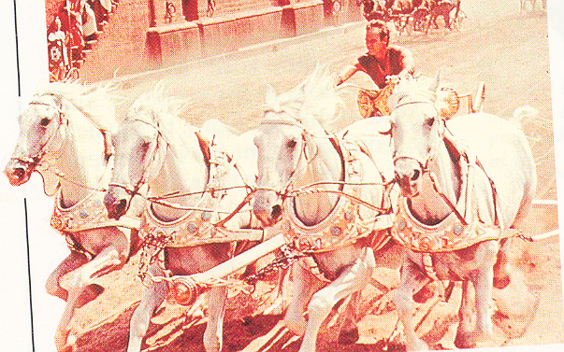
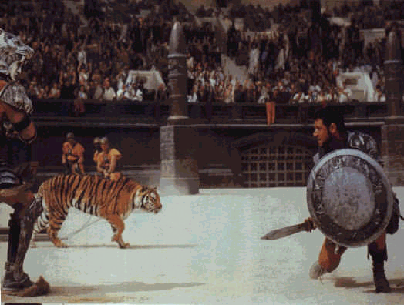
To keep the poor happy, they distributed bread, and had games, races, theaters, and gladiator fights (men against men, men against animals, animals against animals).

Slide 21
Keeping the poor distracted with free food and games was known as "Bread and Circus," or, in Latin., Pan em Circus)

Slide 22

¿What is the name of the country in The Hunger Games?

Slide 23
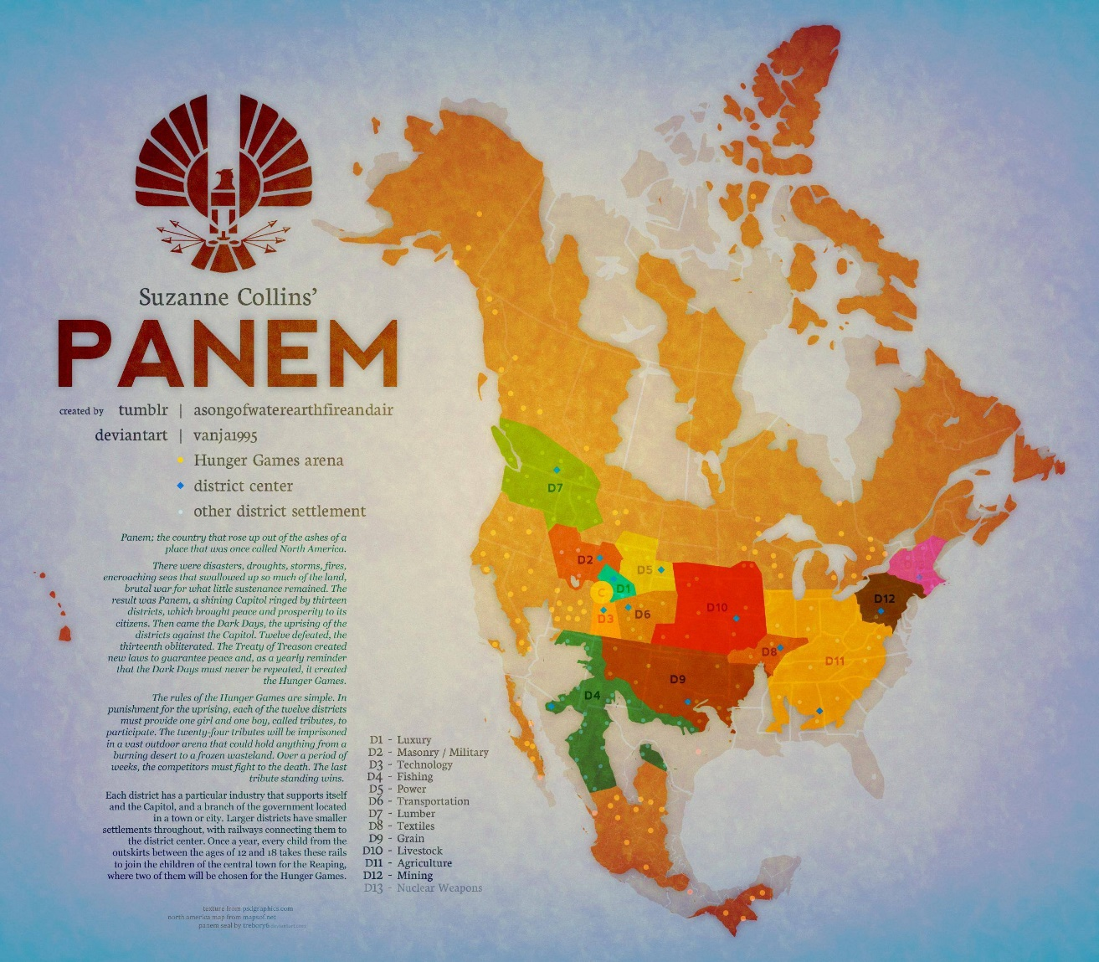
¿What is the name of the country in The Hunger Games?

Slide 24
Keeping the poor distracted with free food and games was known as "Bread and Circus," or, in Latin., Pan em Circus

Slide 25
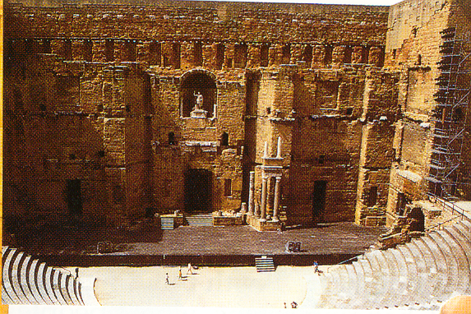
They loved going to the theater, which was inspired by the Greeks.
Women didn't sit in front, why?

Slide 26
The Romans didn't want them to run away with the male actors!
The Romans liked comedies more than tragedies.

Slide 27
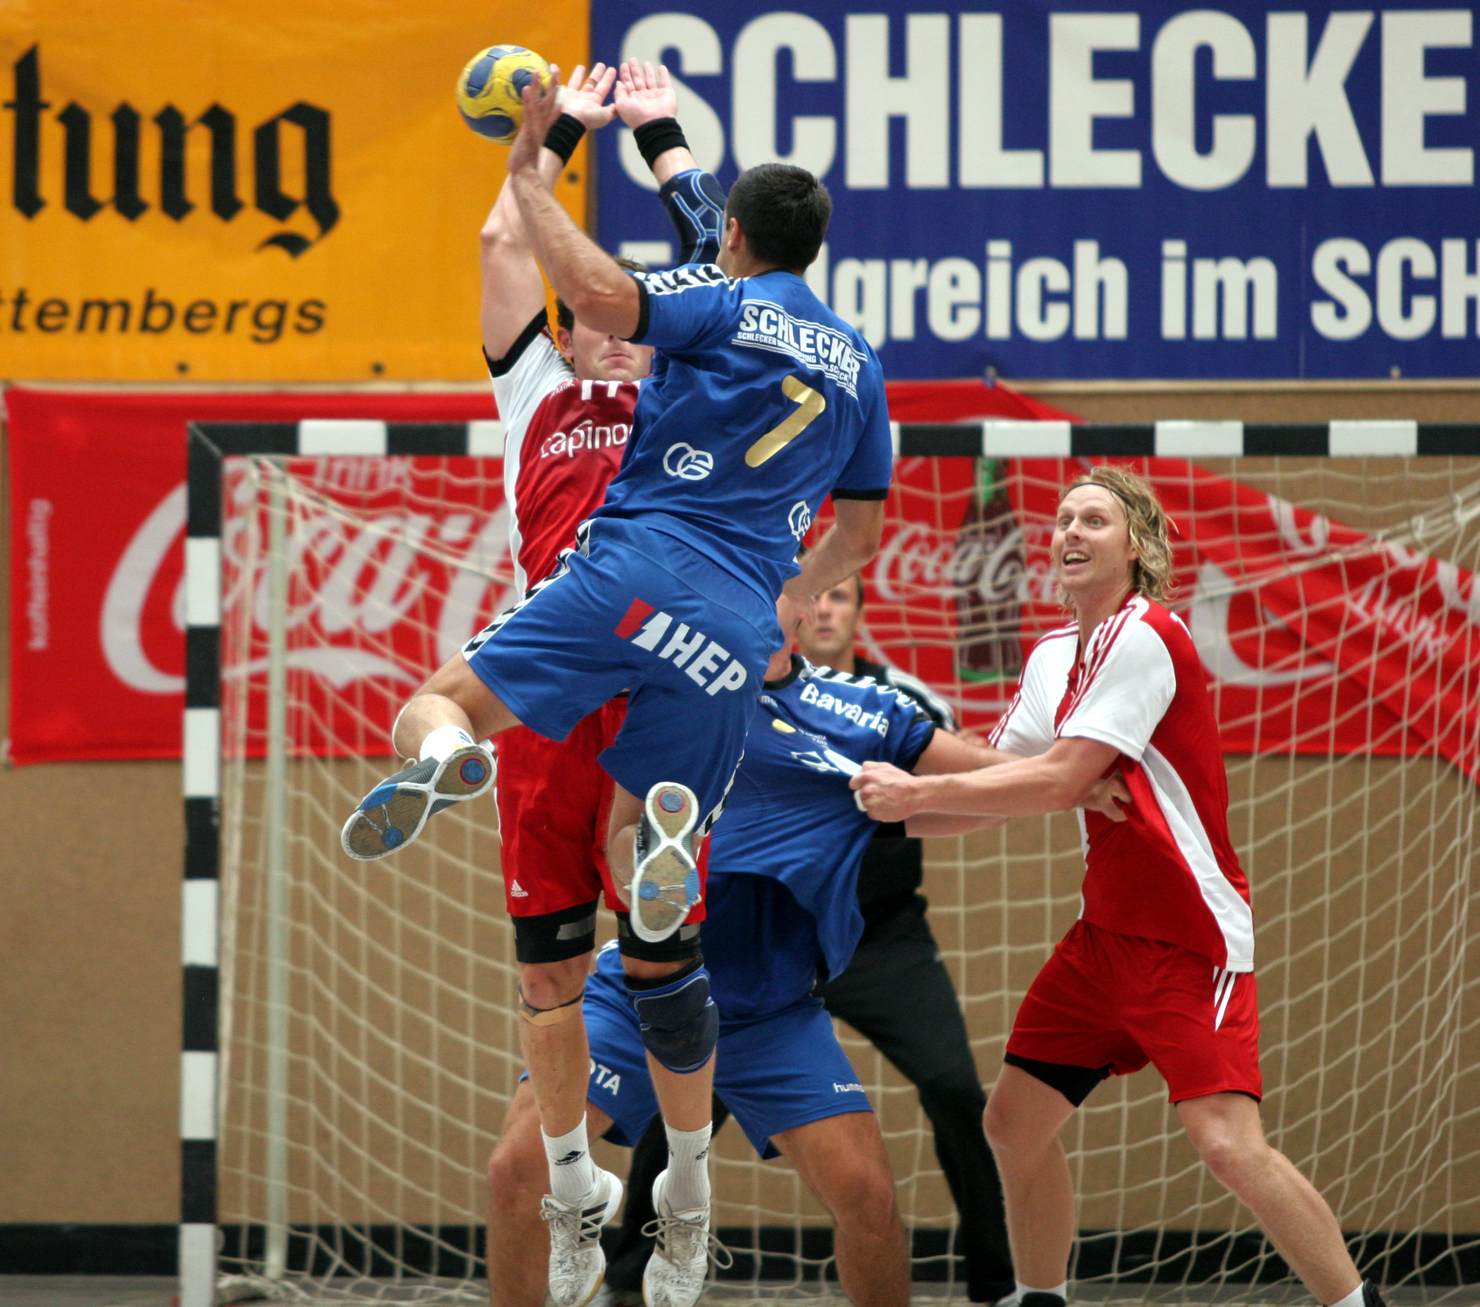
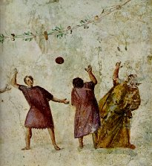
The Romans also played ball games, handball and football versions.
Handball is a popular game in Europe for men and women

Slide 28
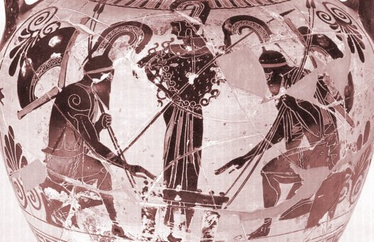
As well as board games, chess, checkers, backgammon and dice!

