Slide 1
The Mayans, Aztecs and Incas

Slide 2
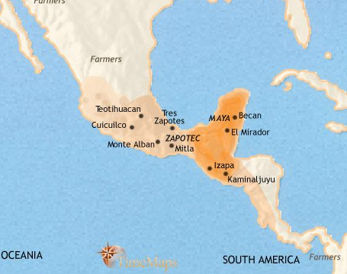
The Mayans, Aztecs and Incas
Whiteheadopia
The Mayans!

Slide 3
The Mayans, Aztecs and Incas
The Mayans
As early as 1500 BCE the Maya had settled in villages and had developed an agriculture based on the cultivation of corn (maize), beans, and squash.

Slide 4
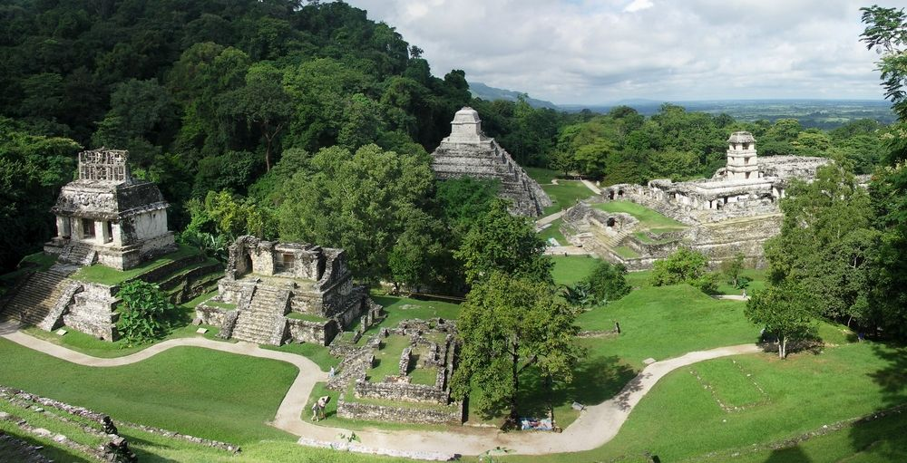
The Mayans, Aztecs and Incas
The Mayans
They began to build ceremonial
centers, and by 200 CE these had developed into cities containing temples, pyramids, palaces, courts for playing ball, and plazas. The ancient Maya quarried immense quantities of building stone (usually limestone), which they cut by using harder stones.

Slide 5
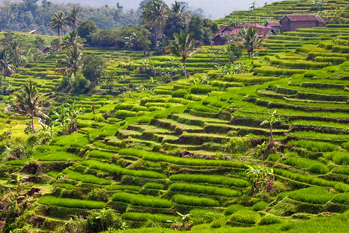
The Mayans, Aztecs and Incas
The Mayans
They practiced mainly slash-and-burn agriculture, but they used advanced techniques of irrigation and terracing.

Slide 6
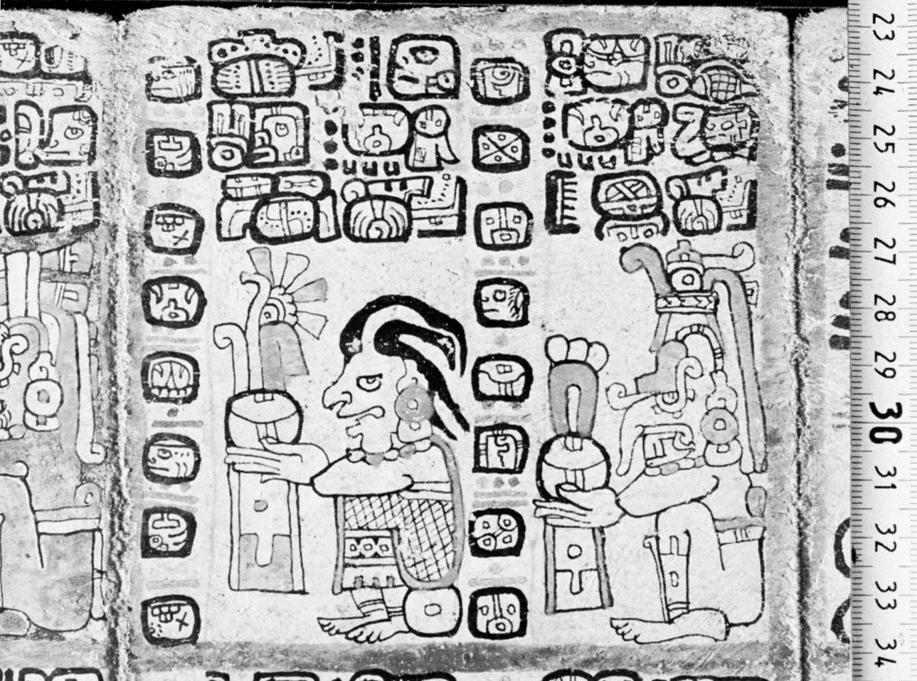
The Mayans, Aztecs and Incas
The Mayans
They also developed a system of hieroglyphic writing and highly sophisticated calendrical and astronomical systems.

Slide 7
The Mayans, Aztecs and Incas
The Mayans
Many of the hieroglyphs depict the histories of the Mayan dynastic rulers, who waged war on rival Mayan cities and took their aristocrats captive. Those captives were then tortured, mutilated, and sacrificed to the gods. Indeed, torture and human sacrifice were thought to guarantee fertility and make the gods happy.

Slide 8
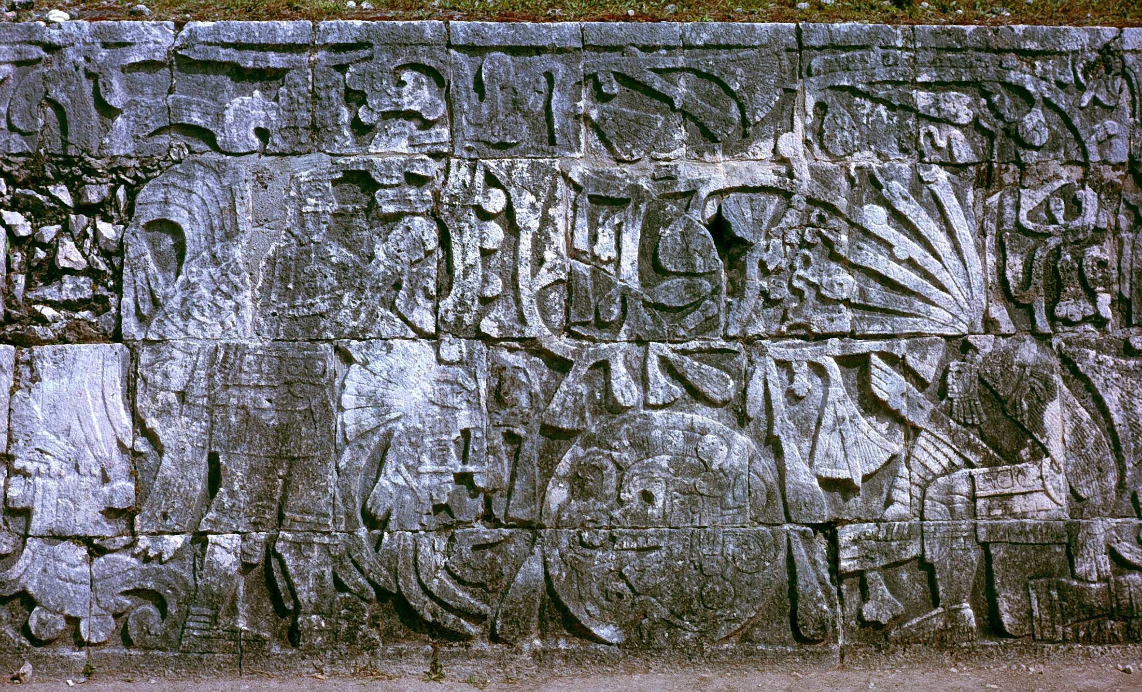
The Mayans, Aztecs and Incas
The Mayans
The Maya made paper from the inner bark of wild fig trees and wrote their hieroglyphs on books made from this paper. Those books are called codices. The Maya also developed an elaborate and beautiful tradition of sculpture and relief carvings.

Slide 9
The Mayans, Aztecs and Incas
The Mayans
The rise of the Maya began about 250 CE, and what is known to archaeologists as the Classic Period of Mayan culture lasted until about 900 CE.

Slide 10
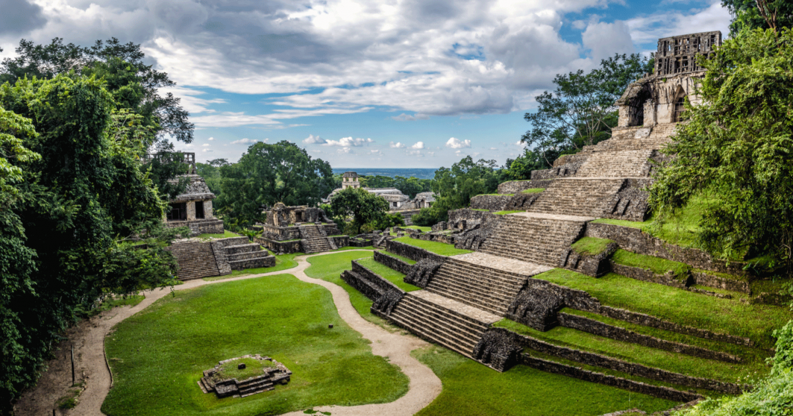
The Mayans, Aztecs and Incas
The Mayans
The peak Mayan population may have reached two million people, most of whom were settled in the lowlands of what is now Guatemala. After 900 CE, however, the Classic Maya civilization declined, leaving the great cities and ceremonial centers vacant and overgrown with jungle vegetation.

Slide 11
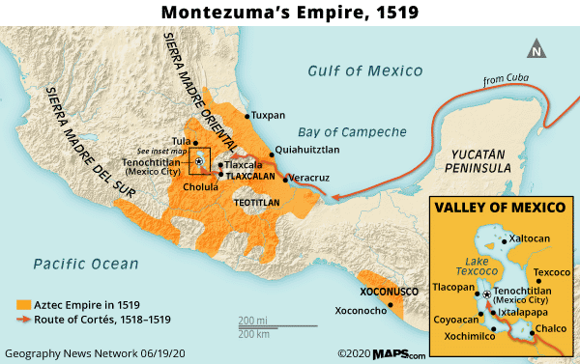
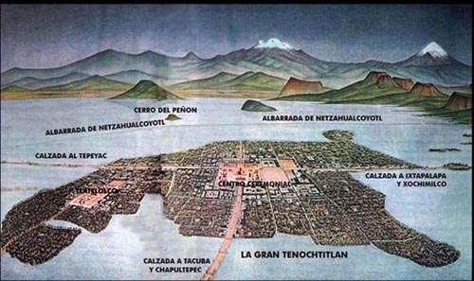
The Mayans, Aztecs and Incas
The Aztecs

Slide 12
The Mayans, Aztecs and Incas
The Aztecs
Migrated from Northern Mexico. When the Aztecs saw an eagle perched on a cactus on the marshy land near the southwest border of Lake Texcoco, they took it as a sign to build their settlement there

Slide 13
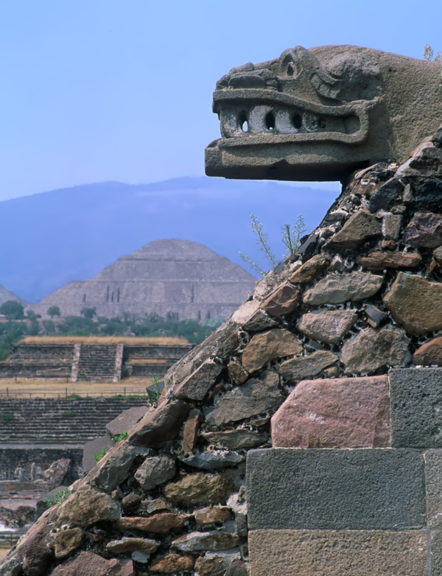
The Mayans, Aztecs and Incas
The Aztecs
They drained the swampy land, constructed artificial islands on which they could plant gardens and established the foundations of their capital city, Tenochtitlan, in 1325 A.D.

Slide 14
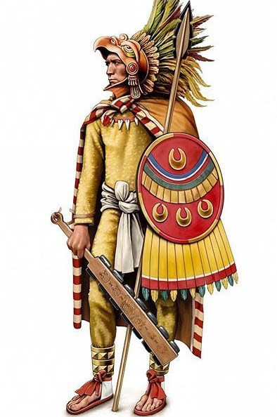
The Mayans, Aztecs and Incas
The Aztecs
In 1428, under their leader Itzcoatl, the Aztecs formed a three-way alliance with two tribes to defeat their most powerful rivals for influence in the region, the Tepanec, and conquer their capital of Azcapotzalco. Itzcoatl’s successor Montezuma I, who took power in 1440, was a great warrior who was remembered as the father of the Aztec empire.

Slide 15
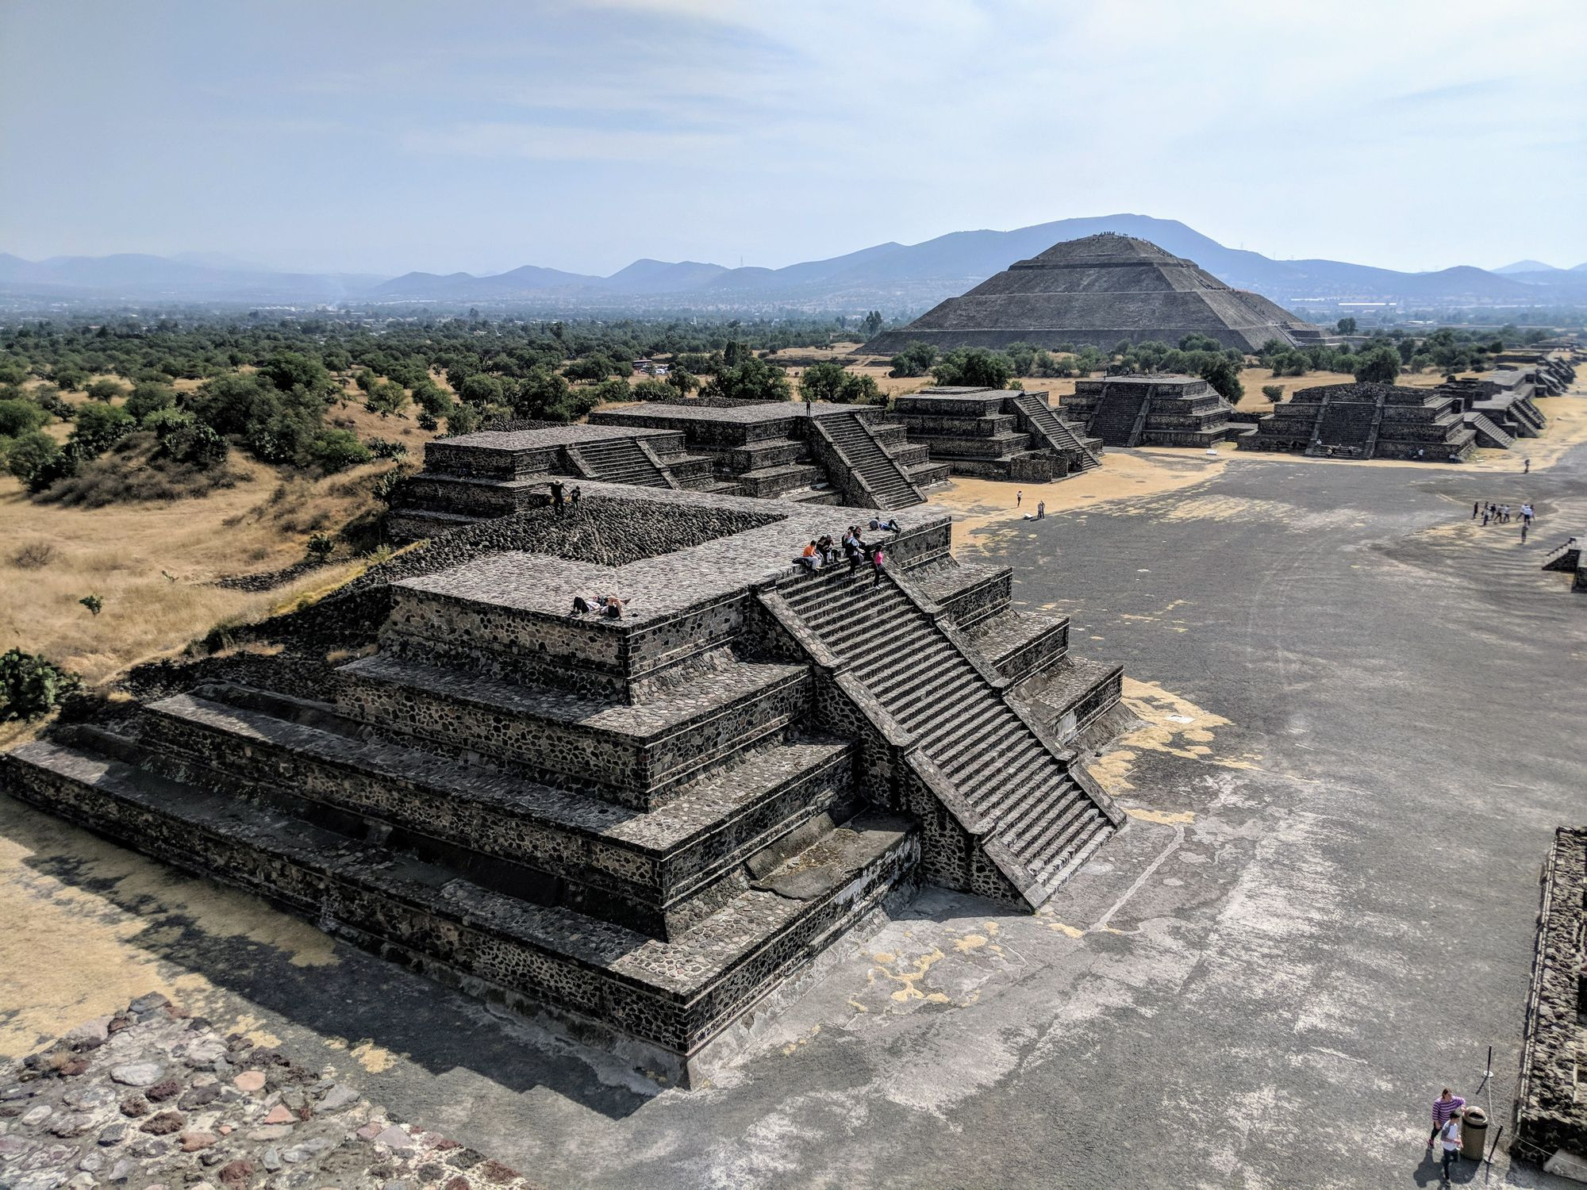
The Mayans, Aztecs and Incas
The Aztecs
By the early 16th century, the Aztecs had come to rule over up to 500 small states, and some 5 to 6 million people, either by conquest or commerce. Tenochtitlán at its height had more than 140,000 inhabitant, and was the most densely populated city ever to exist in Mesoamerica.

Slide 16
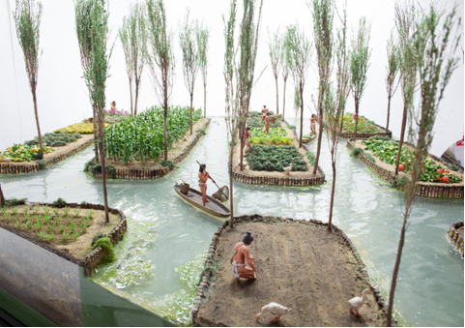
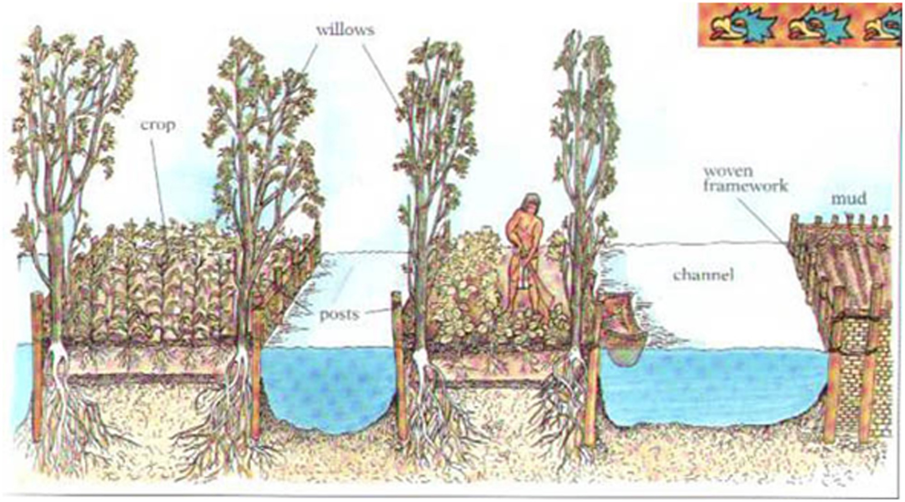
The Mayans, Aztecs and Incas
The Aztecs
Key to the rise of Tenochtitlan was the agricultural system that made it possible to feed the population. Chinampas, small, artificial islands created above the waterline, were one feature of the system. Recordkeeping was important to tracking tributes.

Slide 17
The Mayans, Aztecs and Incas
The Aztecs
Typical Aztec crops included maize (corn), along with beans, squashes, potatoes, tomatoes and avocados; they also supported themselves through fishing and hunting local animals such as rabbits, armadillos, snakes, coyotes and wild turkey.

Slide 18
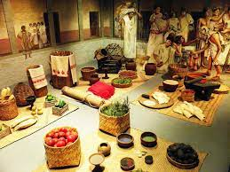
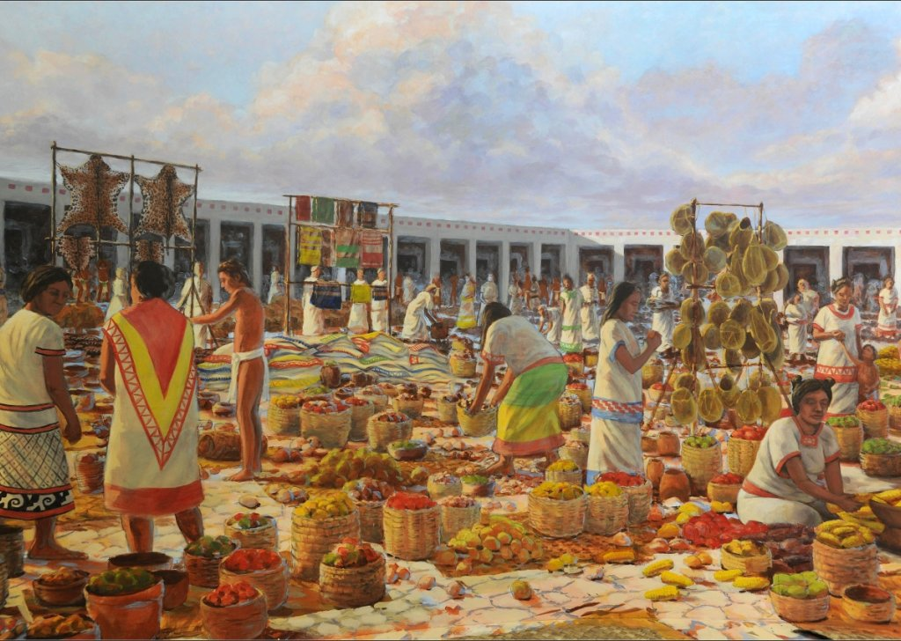
The Mayans, Aztecs and Incas
The Aztecs
Not only the political and religious capital, Tenochtitlan was also a huge trading center with goods flowing in and out such as gold, greenstone, turquoise, cotton, cacao beans, tobacco, pottery, tools, weapons, foodstuffs (tortillas, chile sauces, maize, beans, and even insects, for example) and slaves.

Slide 19
The Mayans, Aztecs and Incas
The Aztecs
The Aztecs followed a strict social hierarchy, a caste system, in which individuals were identified as nobles, commoners, serfs, or slaves.
The noble class consisted of government and military leaders, high level priests, and lords..

Slide 20
The Mayans, Aztecs and Incas
The Aztecs
Women had limited leadership roles within the Aztec empire. There is evidence that they had administrative roles in the calpulli (villages) and markets, and also worked as midwives and priestesses. However, the top administrative positions were limited to men, and women were not permitted to serve as warriors.

Slide 21
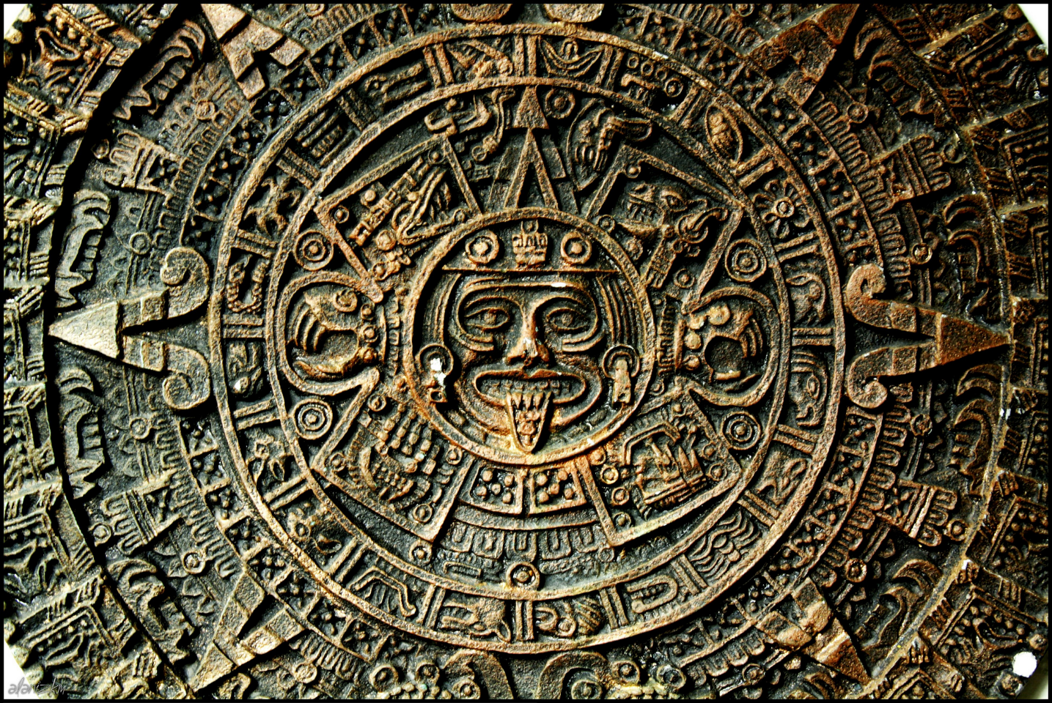
The Mayans, Aztecs and Incas
The Aztecs
Aztec religion shared many of the cosmological beliefs of earlier peoples, notably the Maya, such as that the present earth was the last in a series of creations and that it occupied a position between systems of 13 heavens and 9 underworlds.

Slide 22
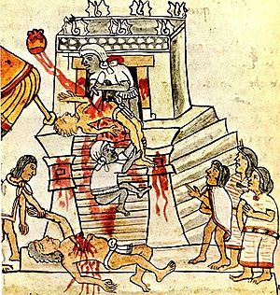
The Mayans, Aztecs and Incas
The Aztecs
Human sacrifice, particularly by offering a victim’s heart to the sun god, Tonatiuh, was commonly practiced, as was bloodletting. Moreover, in order to guarantee human existence, the Aztecs, as “people of the sun,” had to nourish Huitzilopochtli with human blood. For them, ideologically at least, war was therefore a religious obligation that provided prisoners who could be sacrificed to the sun god.

Slide 23
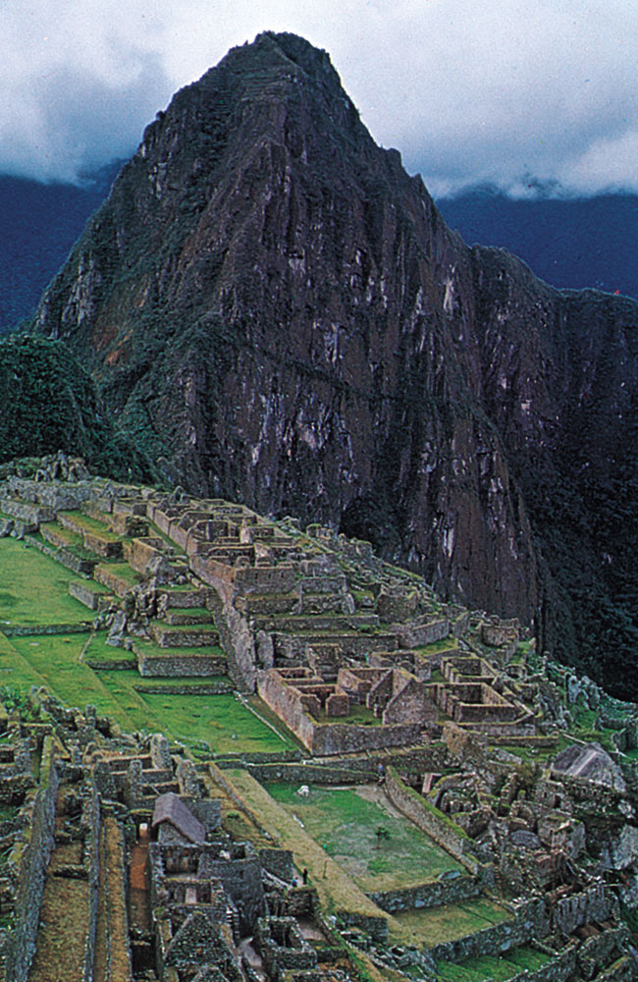
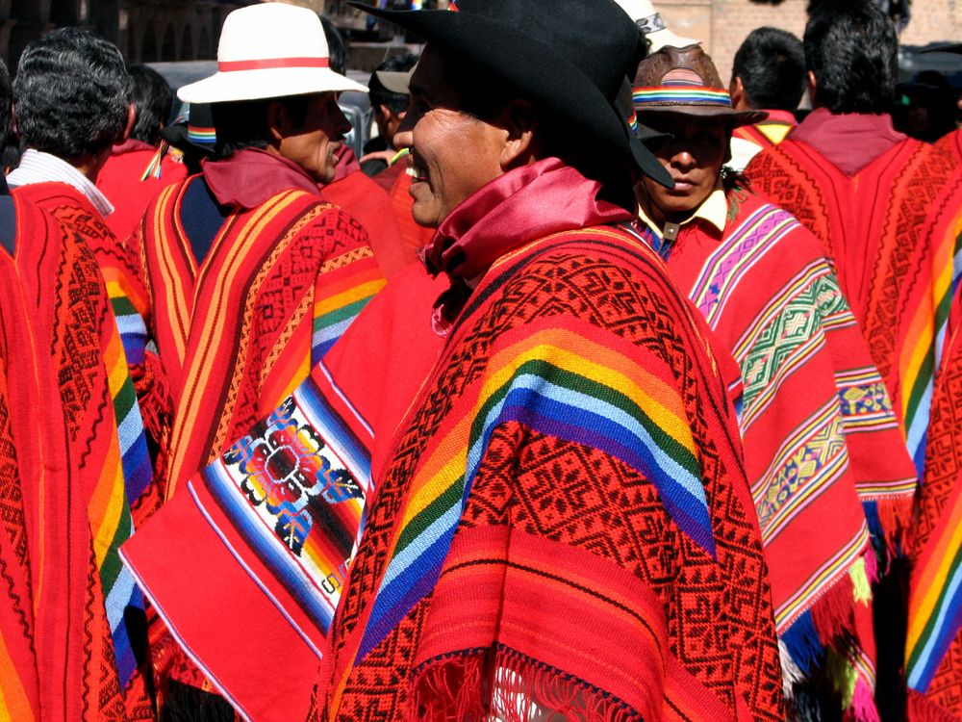
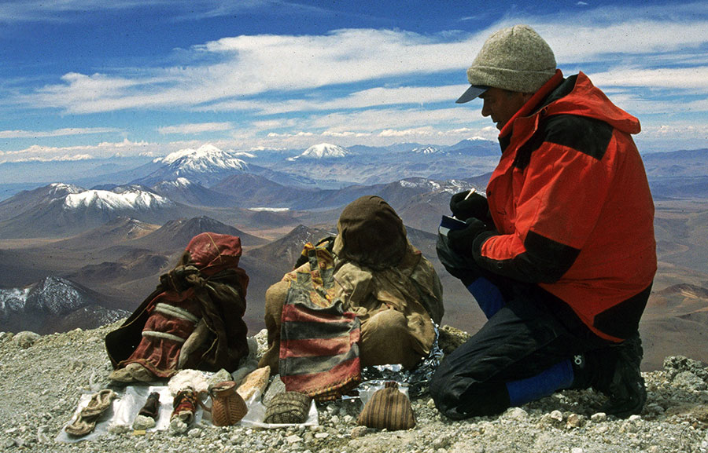
The Mayans, Aztecs and Incas
The Incas

Slide 24
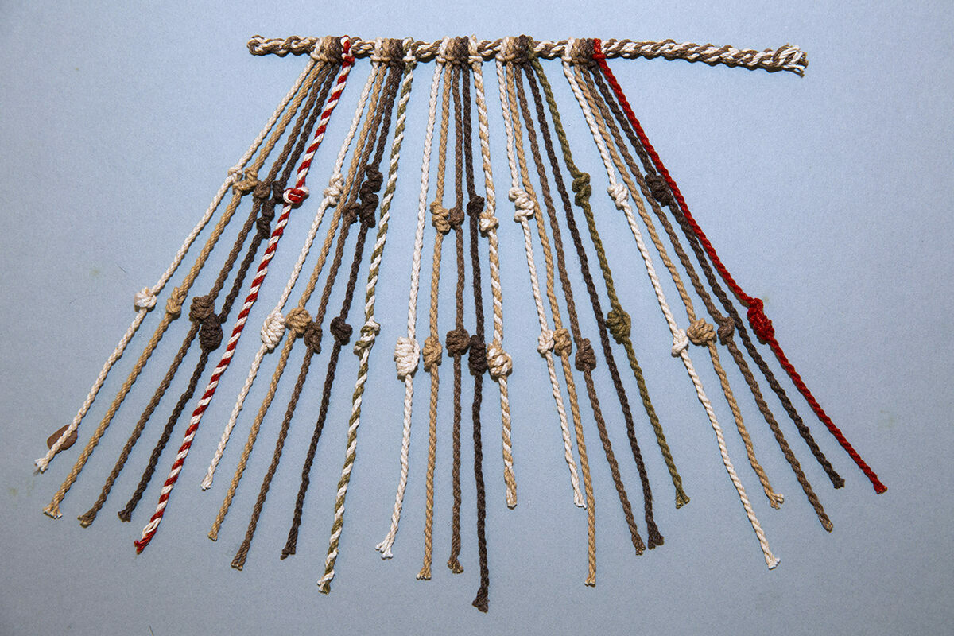
The Incas
The Incas built their empire, called Tawantinsuyu or the "Land of the Four Corners," without the wheel, powerful draft animals, iron working, currency or even what we would consider to be a writing system.

Slide 25
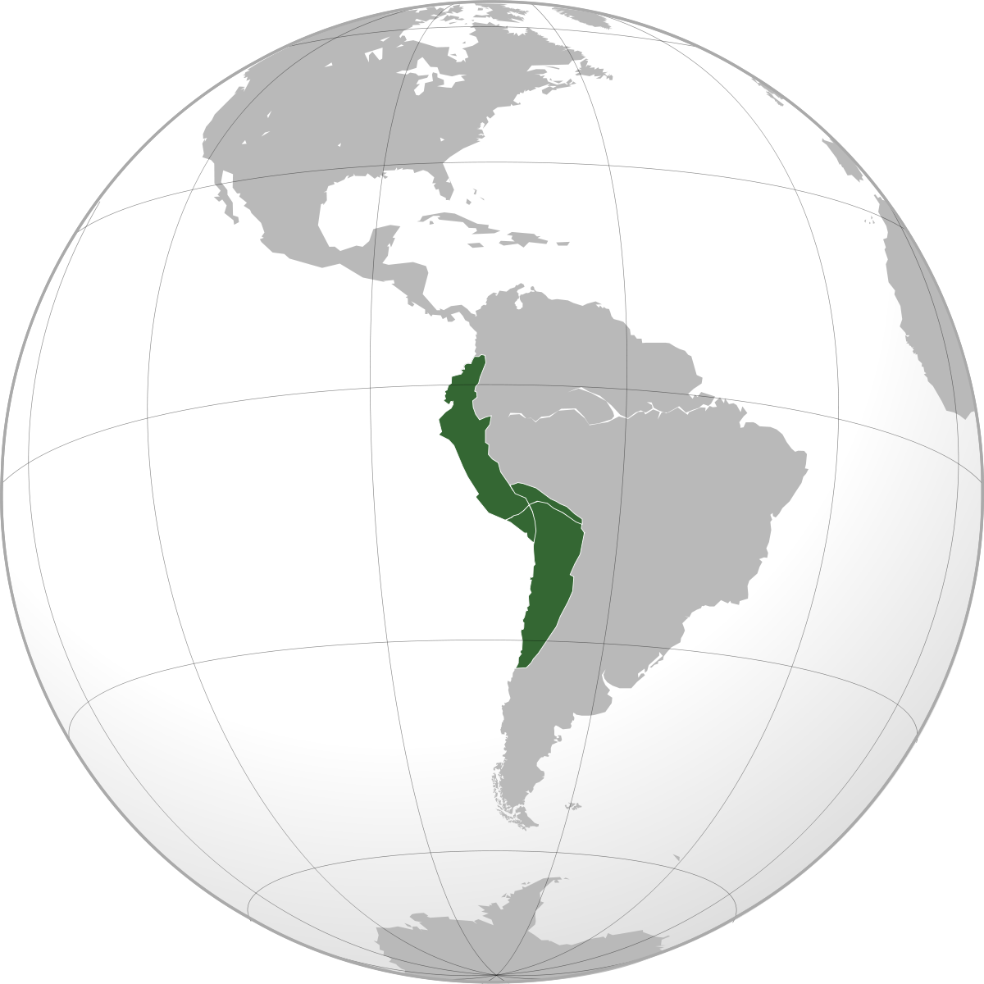
The Incas
The empire stretched from modern-day Argentina to southern Columbia, and was divided up into four “suyu,” which intersected at the capital, Cuzco. These suyu in turn were divided into provinces.

Slide 26
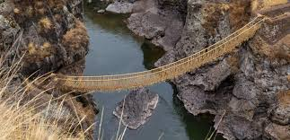
The Incas
A network of highways allowed Inca emperors to control their sprawling empire. One ran down the spine of the Andes, another along the coast.

Slide 27
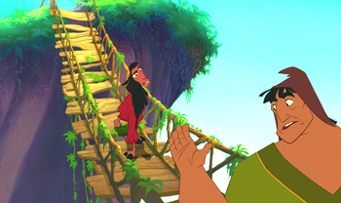
The Incas
Inca builders could cope with anything the treacherous terrain required — steep paths cut along mountain sides, rope suspension bridges thrown across steep ravines, or treacherous walkways traversing floodplains.

Slide 28
The Incas
Every mile and a half they built way stations as resting points. Bands of official runners raced between them covering 150 miles a day. A message could be sent 1200 miles from Cuzco to Quito in under a week.

Slide 29
The Incas
Religion was a mixture of complex ceremonies, practices, animistic beliefs, sacrifices, belief in objects having magical powers, and nature worship—culminated in the worship of the sun, which was presided over by the Inca priests.

Slide 30
The Incas
The economy was based on agriculture, its staples being corn, white and sweet potatoes, squash, tomatoes, peanuts, chili peppers, coca, and cotton. They raised guinea pigs, ducks, llamas, alpacas, and dogs. Clothing was made of llama wool and cotton.

Slide 31
The Incas
Conquering quickly, A policy of forced resettlement of large contingents from each conquered people helped ensure political stability by distributing ethnic groups throughout the empire and thus making the organization of revolt very difficult.
Local governors were responsible for exacting the labor tax on which the empire was based; the tax could be paid by service in the army, on public works, or in agricultural work.

Slide 32
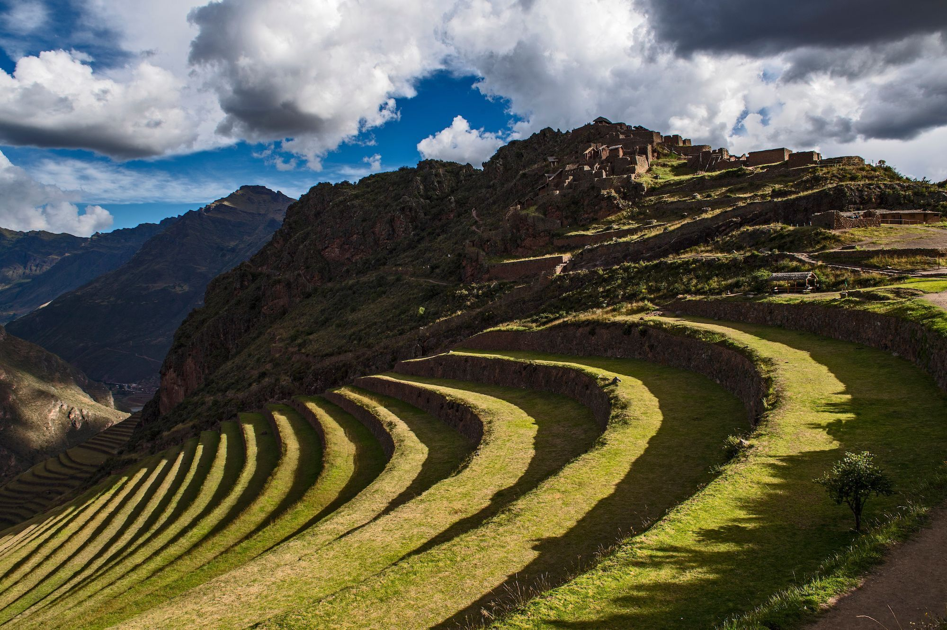
The Mayans, Aztecs and Incas
The Incas
Within its empire were rich coastal settlements, high mountain valleys, rain-drenched tropical forests and the driest of deserts. The Inca controlled perhaps 10 million people, speaking a hundred different tongues. Yet when Pizarro executed its last emperor, Atahualpa, the Inca Empire was only 50 years old.

Slide 33
The Incas
Everyone was expected to contribute to the empire. Land was divided in three. One third was worked for the emperor, one third was reserved for the gods, and one third the people kept for themselves. All were required to pay taxes as tribute.

